Slide 1
Globe : Latitudes and Longitudes
Geography
Class -6
Module-1

Slide 2
Topics to be covered
Globe – definition, uses, merits and demerits
Axis
Latitudes
Equator
Parallels of latitude
Important parallels of latitude
Heat zones of the Earth
Complete the following

Slide 3
GLOBE
We all live on the Earth surface. But do you know its shape?
It is just like a globe, which means slightly flattened at the North and South poles and bulge in the middle.
Globe is a true model of the Earth.

Slide 4
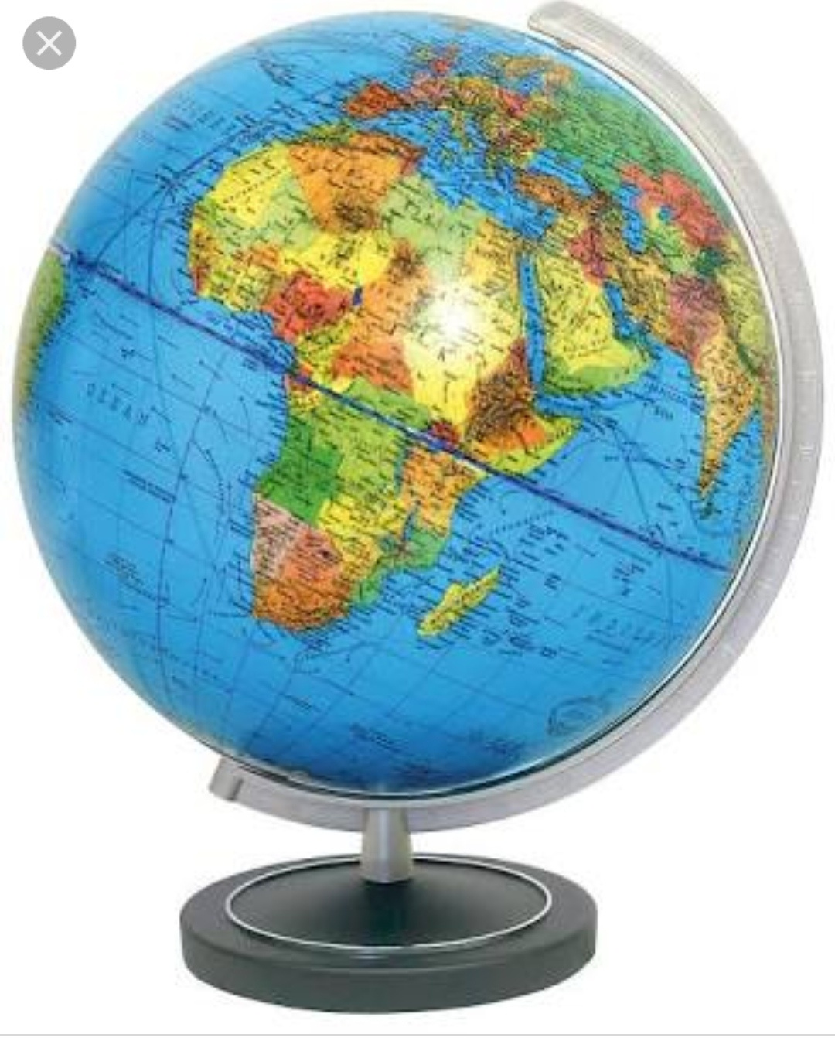

Slide 5
Globe is of different size and types
Big One ( cannot be carried easily)
Small One(Can be carried easily)
Uses of a Globe
We can see different Countries ,Continents and Oceans in their correct size.
Distances and Directions are represented.

Slide 6
Merits and Demerits of the Globe
Merits
It is not a fixed one.
It can be rotated.
Demerits
Difficult to carry.
Only a part of the Earth can be seen.
A needle is fixed through the Globe in a tilled manner, which is called its Axis.
But ,the real Earth has no such needle. It moves around its axis, which is an imaginary line.

Slide 7
Latitude: - An imaginary line that runs horizontally across the surface of the Earth.
Equator:-
An imaginary line running on the globe.
It is a circle that cuts the Earth into two equal halves or hemispheres.
It represents the 0˚ latitude.

Slide 8
Parallels of Latitudes
All the parallel circles from the equator to the poles are called parallels of latitudes.
Latitudes are measured in degrees.

Slide 9
Important Parallels of Latitudes
S.no | Degree | Latitude
1 | 90˚ N | North pole
2 | ½ ˚ N | Arctic Circle
3 | 23 ½ ˚ N | Tropic of Cancer
4 | 0 ˚ | Equator
5 | 23 ½ ˚ S | Tropic of Capricorn
6 | 66 ½ ˚ S | Antarctic Circle
7 | 90 ˚S | South Pole

Slide 10
Heat Zones of the Earth
S.no | Zones | Latitudes | Climate
1 | Torrid Zone | Between Tropic of Cancer and the Tropic of Capricorn | High temperature throughout the year
2 | Temperate Zone | North Temperate Zone: Between the Tropic of Cancer and the Arctic Circle South Temperate Zone: Between the tropic of Capricorn and the Antarctic Circle | Moderate temperature
3 | Frigid Zone | North Frigid Zone: Between the Arctic Circle and the North Pole South Frigid Zone: Between the Antarctic Circle and the south Pole | Very cold

Slide 11
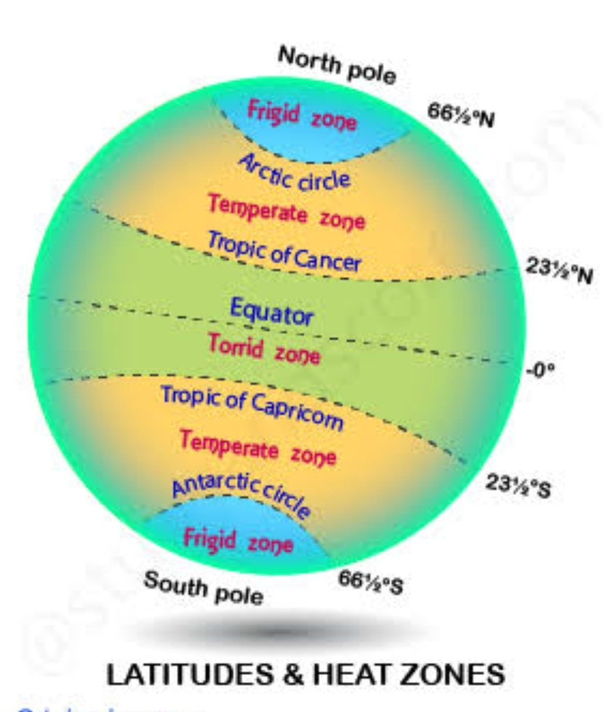

Slide 12
Complete the following:
What is the true shape of the Earth?
What is the latitudinal value of the Tropic of Cancer?
What are the three heat zones of the Earth?
Differentiate between the Torrid zone and Frigid zone.
Write a short note on the Equator.
Activity : Draw a diagram of the Earth showing its axis, the Equator, Tropic of Cancer and Tropic of Capricorn, Arctic and Antarctic Circles.

